Slide 1
Christian Prayer
Using a mantra to become centred, still before God.

Slide 2
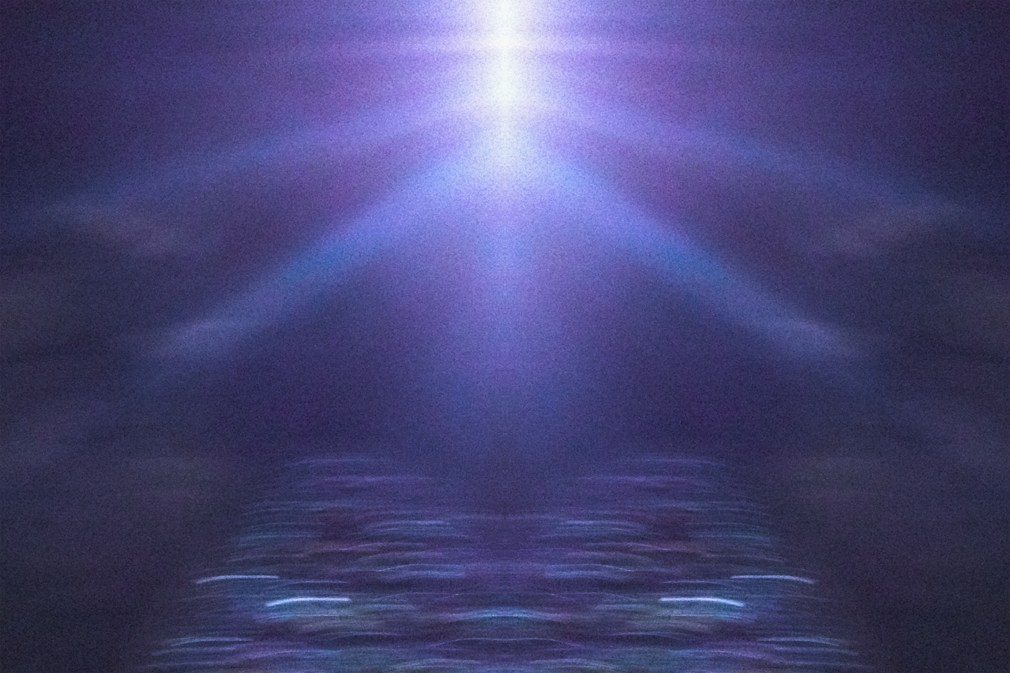

Slide 3
^{Glory be to the Father,} ^{and to the Son,} ^{and to the Holy Spirit} ^{as it was in the beginning,} ^{is now and ever shall be,} ^{world without end. Amen.}

