Slide 1
Christian Prayer
A guided meditation based on the story of the Nativity

Slide 2
A reading from the Holy Gospel according to Luke
Caesar Augustus issued a decree for a census of the whole world to be taken. This census – the first – took place while Quirinius was governor of Syria, and everyone went to his own town to be registered.
So Joseph set out from the town of Nazareth in Galilee and travelled up to Judaea, to the town of David called Bethlehem, since he was of David’s House and line, in order to be registered together with Mary, his betrothed, who was with child.
While they were there the time came for her to have her child, and she gave birth to a son, her first born. She wrapped him in swaddling clothes, and laid him in a manger because there was no room for them at the inn.
In the countryside close by there were shepherds who lived in the fields and took it in turns to watch their flocks during the night. The angel of the Lord appeared to them and the glory of the Lord shone round them. They were terrified, but the angel said, ‘Do not be afraid. Listen, I bring you news of great joy, a joy to be shared by the whole people. Today in the town of David a saviour has been born to you; he is Christ the Lord. And here is a sign for you: you will find a baby wrapped in swaddling clothes and lying in a manger.’
And suddenly with the angel there was a great throng of the heavenly host, praising God and singing: ‘Glory to God in the highest heaven, and peace to men who enjoy his favour.’
^{Luke 2:1-14}

Slide 3
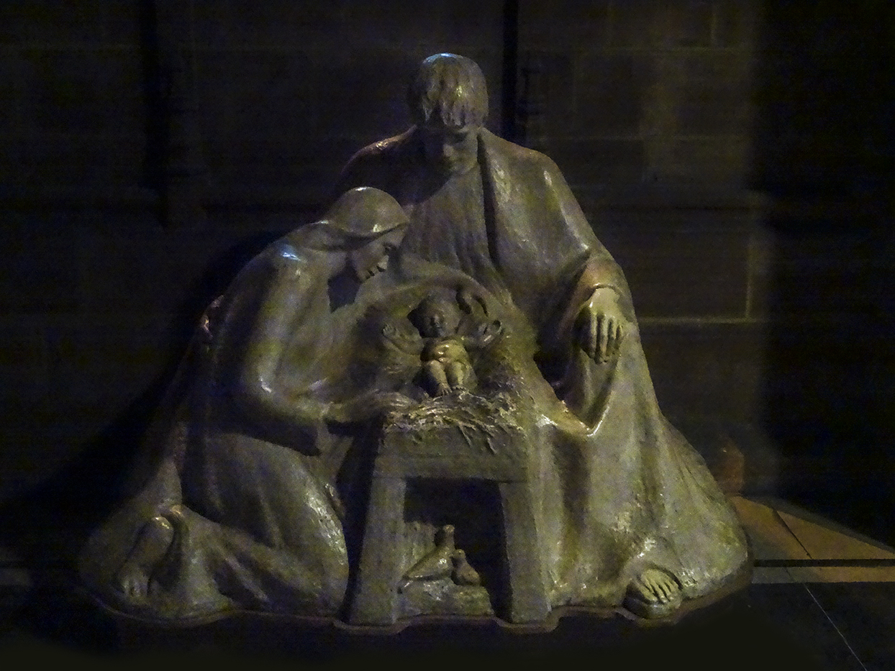

Slide 4
^{Glory be to the Father,} ^{and to the Son,} ^{and to the Holy Spirit} ^{as it was in the beginning,} ^{is now and ever shall be,} ^{world without end. Amen.}

