Slide 1
Christian Prayer
A guided meditation based on the story of Zacchaeus

Slide 2
A reading from the Holy Gospel according to Luke
Jesus entered Jericho and was going through the town when a man whose name was Zacchaeus made his appearance: he was one of the senior tax collectors and a wealthy man. He was anxious to see what kind of man Jesus was, but he was too short and could not see him for the crowd. So he ran ahead and climbed a sycamore tree to catch a glimpse of Jesus who was to pass that way.
When Jesus reached the spot he looked up and spoke to him: ‘Zacchaeus, come down. Hurry, because I must stay at your house today.’ And he hurried down and welcomed him joyfully.
They all complained when they saw what was happening. ‘He has gone to stay at a sinner’s house’ they said. But Zacchaeus stood his ground and said to the Lord, ‘Look, sir, I am going to give half my property to the poor, and if I have cheated anybody I will pay him back four times the amount.’
And Jesus said to him, ‘Today salvation has come to this house, because this man too is a son of Abraham; for the Son of Man has come to seek out and save what was lost.’
^{Luke 19:1-10}

Slide 3
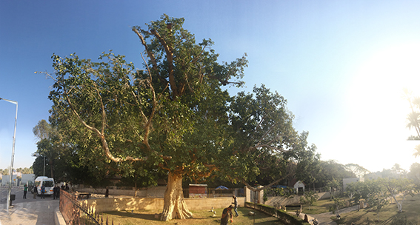

Slide 4
^{Glory be to the Father,} ^{and to the Son,} ^{and to the Holy Spirit} ^{as it was in the beginning,} ^{is now and ever shall be,} ^{world without end. Amen.}

